Slide 1
ECE428 :
Programmable ASIC Design
Haibo Wang
ECE Department
Southern Illinois University
Carbondale, IL 62901
1-<number>

Slide 2
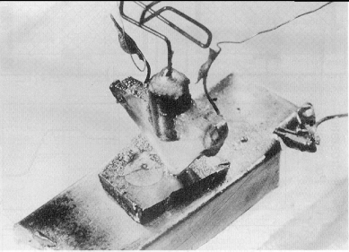
The evolution of Integrated Circuits
1948: Invention of transistor (Bell Labs)
1958: Invention of Integrated Circuits
The idea of making a whole circuit-transistors, wires, and everything else-was
invented by Jack Kilby at Texas Instruments and Robert Noyce at Fairchild
Semiconductor almost at the same time.
1965: Moore’s Law
In 1965, Gordon Moore at Intel made a prediction that semiconductor technology
will double its effectiveness every 18 months
1-<number>

Slide 3
Moore’s Law in Microprocessors
1000
100
2X growth in 1.96 years!
10
P6
Transistors (MT)
Pentium® proc
1
486
386
0.1
286
8085
8086
0.01
8080
8008
0.001
4004
1970
1980
1990
2000
2010
Year
Source from http://infopad.eecs.berkeley.edu/~icdesign
1-<number>

Slide 4
Clock frequencies of Microprocessors
10000
Doubles every
2 years
1000
100
P6
Frequency (Mhz)
Pentium ® proc
486
10
8085
286
386
8086
1
8080
8008
0.1
4004
1970
1980
1990
2000
2010
Year
Source from http://infopad.eecs.berkeley.edu/~icdesign
1-<number>

Slide 5
Classifications of Integrated Circuits
Microprocessors
Memory chips (SRAM, DRAM, Flash, ROM, PROM)
Standard Components (74LS..)
Application-Specific Integrated Circuits
Widely used in communication, network, and multimedia systems
For a given application, ASIC solutions are normally more
effective than the solutions based on running software on
microprocessors
Many chips in cellular phones, network routers, and game consoles
are ASICs
Most SoC (Systems-on-a-Chip) chips are ASICs
1-<number>

Slide 6
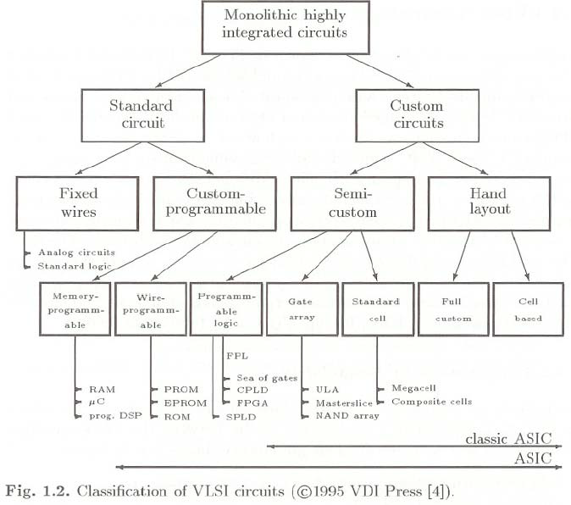
Classification of VLSI Circuits
1-<number>

Slide 7
ASIC Design Methodologies
ASIC Design Methodology
Full-custom
design
Standard-cell
based design
Gate-array
based design
FPGA based
design
This approach is
extremely slow,
expensive
This approach is
reasonable fast,
less expensive
This approach is
fast and less
expensive
The design process
is very fast and
cost effective
It is only used to
design very high
performance
systems
Most ASICs are
currently designed
using this method
ASIC performance
are relatively slow
ASIC performance
are slow
1-<number>

Slide 8
Full-Custom Design Methodology
Function Partition
Layout Design
Including placement & routing
Schematic Design
Including transistor sizing
Post-Layout
simulation
Fail
Function
And Timing
verification
Pass
Fail
Go to fabrication
Pass
ASIC Chips
It is a time consuming manual process, not pre-developed libraries needed.
1-<number>

Slide 9
Full-Custom Design Methodology
Design a chip from scratch.
Engineers design some or all of the logic cells, circuits,
and the chip layout specifically for a full-custom IC.
Custom mask layers are created in order to fabricate
a full-custom IC.
Advantages: complete flexibility, high degree of
optimization in performance and area.
Disadvantages: large amount of design effort, expensive.
1-<number>

Slide 10
Standard-Cell Based Design Methodology
High-level (RTL or behavioral-level) design
VHDL or Verilog coding
Fail
High-level verification
VHDL or Verilog simulation
Pass
Logic synthesis
Logic gate library
Fail
Gate-level verification
Pass
Placement & Routing
Cell layout library
Fail
Pass
Post-Layout verification
Go to fabrication
It is highly automated, but need pre-developed libraries.
1-<number>

Slide 11
Standard-Cell Based Design Methodology
Use pre-developed logic cells from standard-cell library as
building blocks.
As full-custom design, all mask layers need to be customized to
fabricate a new chip.
Advantages: save design time and money, reduce risk
compared to full-custom design.
Disadvantages: still incurs high non-recurring-engineering
(NRE) cost and long manufacture time.
Library Cells
D
A
A
A
B
B
D
C
C
D
Chip layout
1-<number>

Slide 12
Gate-Array Based Design Methodology
The netlist can be designed
using full-custom or
standard-cell based
design method
Generating schematic (netlist)
Placement & Routing
Cell layout library
Post-Layout verification
Make the final connections for the
pre-fabricated gate array base
Pre-fabricated gate array template
It contains transistors
without connections
ASIC Chips
This approach is faster than the standard-cell based approach because part of
the fabrication process has been complete.
1-<number>

Slide 13
Gate-Array Based Design Methodology
Parts of the chip (transistors) are pre-fabricated, and other parts
(wires) are custom fabricated for a particular customer’s circuit.
Gate Array
Sea-of-Gates
Advantages: cost saving (fabrication cost of a large number of
identical template wafers is amortized over different
customers), shorter manufacture lead time.
Disadvantages: performance not as good as full-custom or
standard-cell-based ICs.
1-<number>

Slide 14

FPGA Based Design Methodology
Schematic
Capture
HDL coding &
Logic Synthesis
netlist
FPGA cell
library
Technology mapping
Placement & routing
Implementation
Fail
Verification
Timing verification
Pass
Download
Generate FPGA Bit Stream
FPGA
This approach has extremely fast turn-out time since FPGA devices has been
fabricated.
1-<number>

Slide 15
Comparison of Design Methodologies
 | Full-custom design | Standard-cell based design | Gate-array based design | FPGA-based design
Speed | +++ | ++ | + | -
Integration density | +++ | ++ | + | --
High-volume device cost | ++ | ++ | + | +
low-volume device cost | --- | -- | + | +++
Custom mask layer | All | All | Some | None
Fabrication time | --- | -- | - | +++
Time to Market | --- | -- | ++ | +++
Risk reduction | --- | -- | - | +++
Future design modification | --- | -- | - | +++
+ desirable; - not desirable
1-<number>

Slide 16
Why do we want FPGAs
Advantages of using FPGAs
Fast turn-out time
The ability of re-programming
The capability of dynamic reconfiguration
FPGA Applications
Ideal platform for prototyping
Providing fast implementation to reduce time-to-market
Cost effective solutions for products with small volumes on demand
Implementing hardware systems requiring re-programming flexibility
Implementing dynamically re-configurable systems
1-<number>

Slide 17
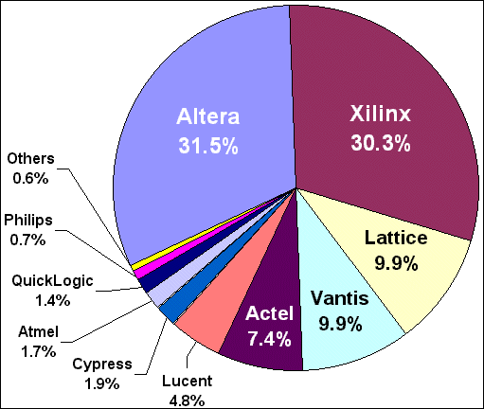
FPGA Market
Market Share in 1998
Total Revenue is above two billion U.S. Dollar
Source from http://www.optimagic.com/
Current FPGA revenue is about 3.6B USD.
Major players include: Xilinx, Altera, Actel, Lattice, Atmel, Cypress,
QuickLogic, SiliconBlue
1-<number>

Slide 18
The State-of-Art of FPGAs
Various types of FPGAs are available for different applications
Modern FPGAs are fabricated using the most advanced technology
and are capable to implement very high performance systems
For example, the latest Xilinx Virtex-II Pro FPGAs are fabricated using
90 nm technology, containing more than one million gates. Such devices
also include PowerPC microprocessor, on-chip memories, and
3.125Gbit/s I/O interfaces.
Currently, FPGAs are widely used in implementing communication
systems, configurable computers, and DSP applications
1-<number>

Slide 19
Typical FPGA Architectures
FPGA I/O cell
Configurable Logic Block
Configurable Interconnects
FPGA I/O cell
Configurable Interconnects
1-<number>

Slide 20
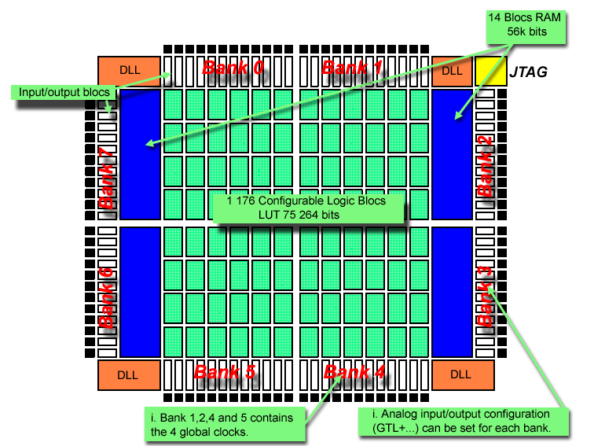
Examples of FPGA Architectures
http://www.xilinx.com
1-<number>

Slide 21

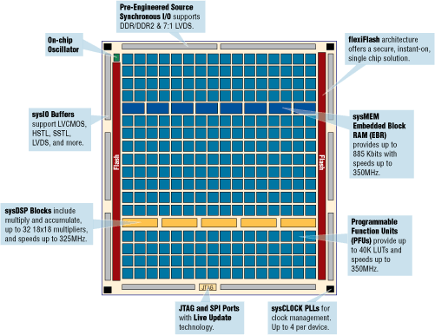
Examples of FPGA Architectures
www.latticesemi.com/images/img24483.gif
1-<number>

Slide 22
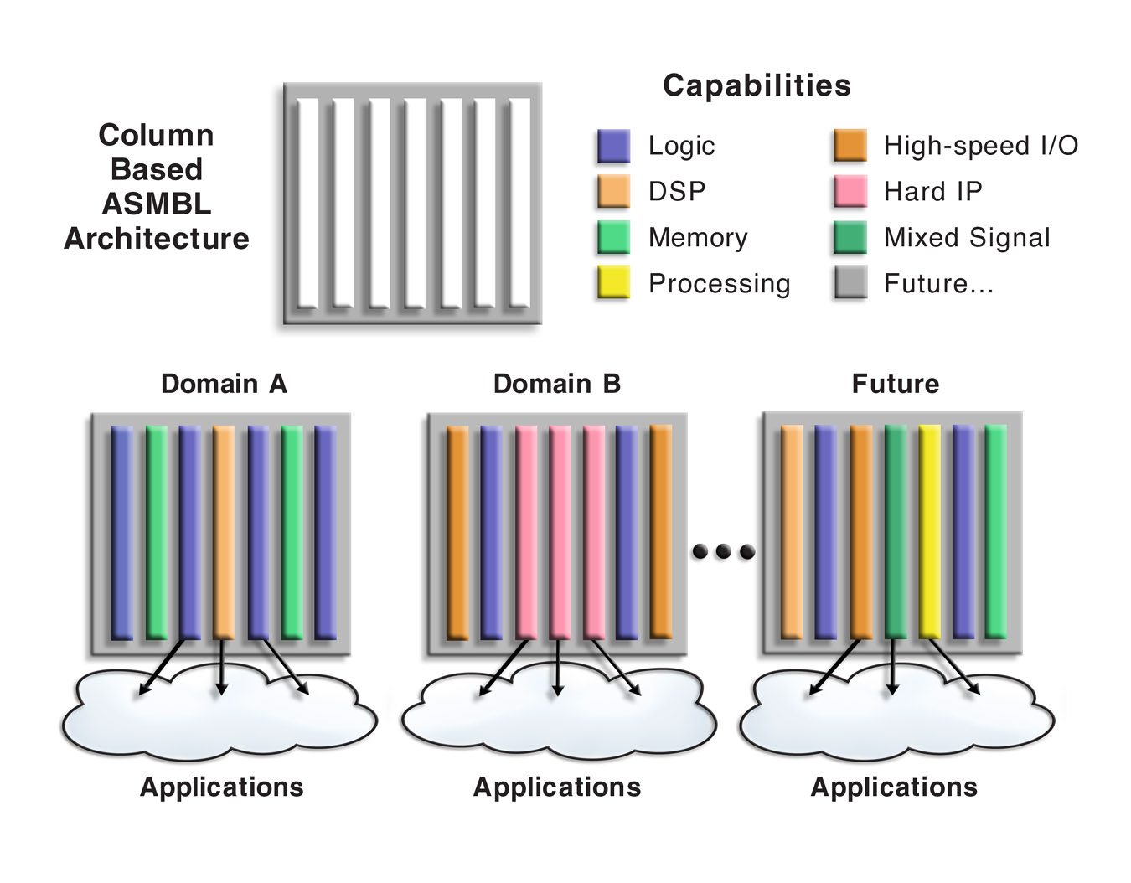
Examples of FPGA Architectures
http://www.xilinx.com
1-<number>

Slide 23
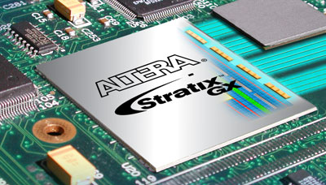
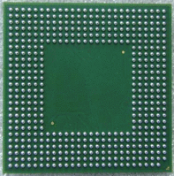
Examples of FPGA Package
An FPGA with BGA package on PCB
Back view of Ball Grid Array (BGA)
www.altera.com
http://www.bluemelon.org/index.php/Projects/FPGA_design
1-<number>

Slide 24
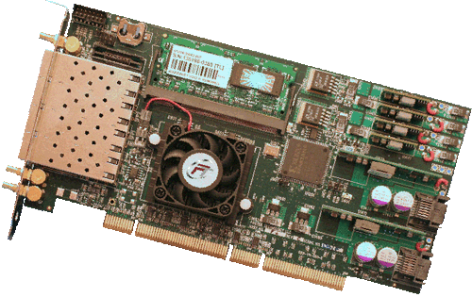
Examples of FPGA Applications
Reconfigurable computing & hardware accelerator
http://www.fastertechnology.com/
1-<number>

Slide 25
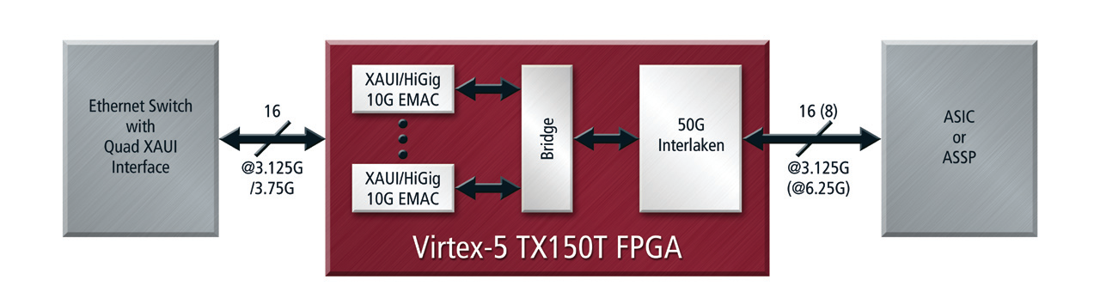
Examples of FPGA Applications
40Gbps datapath for internet connection
http://www.xilinx.com/publications/prod_mktg/pn2094.pdf
1-<number>

Slide 26
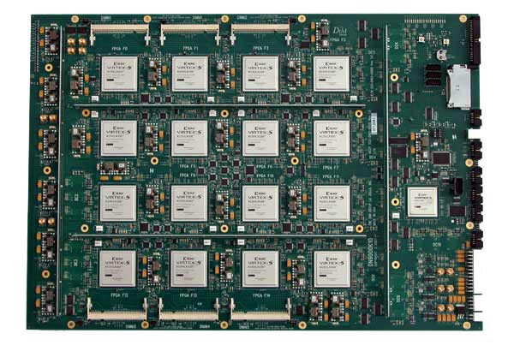
Examples of FPGA Applications
Logic emulation
www.applistar.com/top/DN9000K10.jpg
1-<number>

